Slide 1
Data Science - Reinforcement Learning
Frank Wei
fweital@gmail.com

Slide 2
Who am I?
Expert in delivering solutions for research and industry problems
Problem driven professional experienced in data science
Hands on expertise in statistical analysis and artificial intelligence
Notes:
我叫frank，非常高兴被邀请来分享我在data science这个领域，尤其是在reinforcement learning，的一些经验。
我现在的职位是一个r&d role。需要做research同时也会有development的工作。
我们是一个statistical agency，有很多和survey相关的工作。
职业初期，我做的更多的是统计方面的工作，关于一些统计推断，用MCMC做数据imputation，survey weight calibration这样。Work mostly with statisticians。
后来，随着机器学习的发展，我开始更多的变成了一个problem-driven的人。最近两个project，reinforcement learning用来改进synthetic population。
对于统计来讲，更注重的是数学上的合理性，而不是给予结果的表现。比如对于线性模型，要先去看goodness of fit，而不是简简单单的从模型结果来评估模型。所以prediction并不是它所擅长的。
而对于机器学习，结果是它更大的concern，所以机器模型的很大一部分工作就是调loss function。我的困惑
Firstly, we must understand that statistics and statistical models are not the same. Statistics is the mathematical study of data. You cannot do statistics unless you have data. A statistical model is a model for the data that is used either to infer something about the relationships within the data or to create a model that is able to predict future values. Often, these two go hand-in-hand.
To make this slightly more explicit, there are lots of statistical models that can make predictions, but predictive accuracy is not their strength.

Slide 3
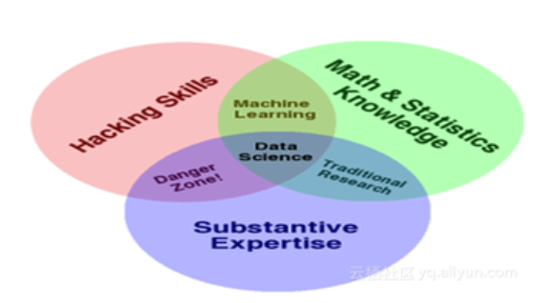
What is data science
Notes:
交叉学科
Tell a story from the data
发现问题，理解问题，理解数据，和business ppl或者domain scientist多交流，process data
寻找合适模型，解释结果

Slide 4
What is data science
Slides!
Notes:
交叉学科
Tell a story from the data
发现问题，理解问题，理解数据，和business ppl或者domain scientist多交流，
寻找合适模型，解释结果

Slide 5
Outline
Introduction to Reinforcement Learning
Scale down problem to math form
Case study – Atari games
Integrated with my research

Slide 6
Introduction to Reinforcement Learning - Machine Learning
Gives the computer that which makes it more similar to humans: The ability to learn
Supervised Learning
Unsupervised learning
Reinforcement learning

Slide 7
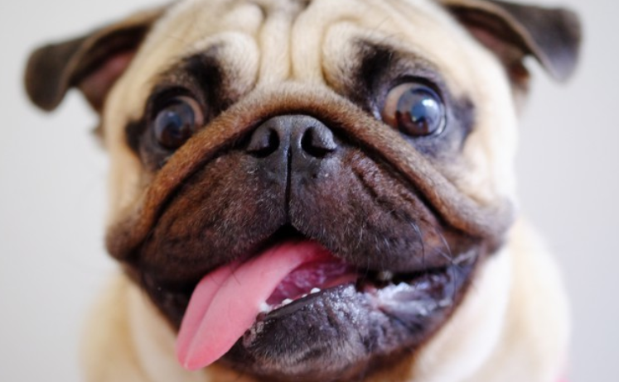
Introduction to Reinforcement Learning - Supervised Learning
Dog
Data (X, Y)
X is data, Y is label
Goal:
Learn a function to map X->Y
Examples: Classification, regression,
object detection, semantic
segmentation, image captioning, etc
Classification

Slide 8
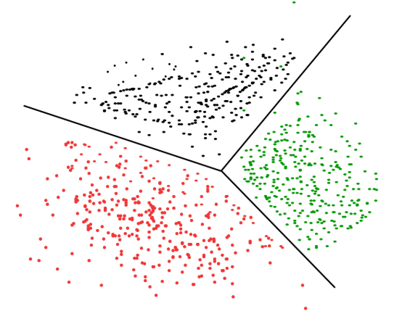
Introduction to Reinforcement Learning - Unsupervised Learning
Data: X. Just data, no labels!
Goal: Learn some underlying
hidden structure of the data
Examples: Clustering,
dimensionality reduction,
feature learning, density estimation, etc

Slide 9
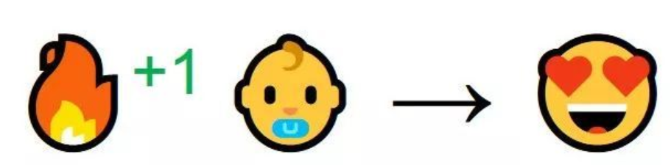

Introduction to Reinforcement Learning - Reinforcement Learning
Notes:
强化学习的中心思想，就是让智能体在环境里学习。每个行动会对应各自的奖励，智能体通过分析数据来学习，怎样的情况下应该做怎样的事情。
其实，这样的学习过程和我们自然的经历非常相似。想象1个小孩子，第一次看到了火，然后走到了火边。
你感受到了温暖。火是个好东西 (+1) 。
然后就试着去摸。卧槽，这么烫 (-1) 。
结论是，在稍远的地方火是好的，靠得太近就不好。
这就是人类学习的方式，与环境交互。强化学习也是一样的道理，只是主角换成了计算机。
它主要包含四个元素，agent，环境状态，行动，奖励, 强化学习的目标就是获得最多的累计奖励。
让我们以小孩学习走路来做个形象的例子：
小孩想要走路，但在这之前，他需要先站起来，站起来之后还要保持平衡，接下来还要先迈出一条腿，是左腿还是右腿，迈出一步后还要迈出下一步。
小孩就是 agent，他试图通过采取行动（即行走）来操纵环境（行走的表面），并且从一个状态转变到另一个状态（即他走的每一步），当他完成任务的子任务（即走了几步）时，孩子得到奖励（给巧克力吃），并且当他不能走路时，就不会给巧克力。

Slide 10
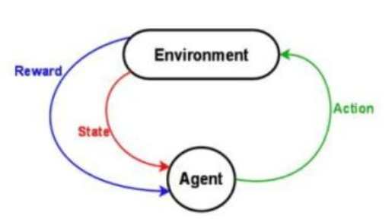
Introduction to Reinforcement Learning - Reinforcement Learning
Goal:
Learn how to take actions in order to maximize reward
Notes:
强化学习介于监管和非监督式学习之间，监督式学习需要告诉机器训练数据label，非监督式学习不需要，而强化学习是稀疏和延时的标签--即奖励。 仅仅基于这些奖励，代理必须学习在环境中的行为。
<A, S, R, P>就是RL中经典的四元组了。A代表的是Agent的所有动作；State是Agent所能感知的世界的状态；Reward是一个实数值，代表奖励或惩罚；P则是Agent所交互世界，也被称为model。
强化学习的过程是智能体通过与环境交互，不断试错并提升决策能力的过程。通过观察状态，执行动作并获得回报，智能体根据某种学习方法不断进步并习得最优决策。深度强化学习是指将深度神经网络与强化学习相结合，利用神经网络的拟合能力和强化学习的决策能力，在广泛的任务上取得了优异的效果。
监督式学习就好比你在学习的时候，有一个导师在旁边指点，他知道怎么是对的怎么是错的，但在很多实际问题中，例如 chess，go，这种有成千上万种组合方式的情况，不可能有一个导师知道所有可能的结果。
而这时，强化学习会在没有任何标签的情况下，通过先尝试做出一些行为得到一个结果，通过这个结果是对还是错的反馈，调整之前的行为，就这样不断的调整，算法能够学习到在什么样的情况下选择什么样的行为可以得到最好的结果。
两种学习方式都会学习出输入到输出的一个映射，监督式学习出的是之间的关系，可以告诉算法什么样的输入对应着什么样的输出，强化学习出的是给机器的反馈 reward function，即用来判断这个行为是好是坏。
另外强化学习的结果反馈有延时，有时候可能需要走了很多步以后才知道以前的某一步的选择是好还是坏，而监督学习做了比较坏的选择会立刻反馈给算法。
而且强化学习面对的输入总是在变化，每当算法做出一个行为，它影响下一次决策的输入，而监督学习的输入是独立同分布的。
通过强化学习，一个 agent 可以在探索和开发（exploration and exploitation）之间做权衡，并且选择一个最大的回报。 exploration 会尝试很多不同的事情，看它们是否比以前尝试过的更好。 exploitation 会尝试过去经验中最有效的行为。
一般的监督学习算法不考虑这种平衡，就只是是 exploitative。
强化学习和非监督式学习的区别：
非监督式不是学习输入到输出的映射，而是模式。例如在向用户推荐新闻文章的任务中，非监督式会找到用户先前已经阅读过类似的文章并向他们推荐其一，而强化学习将通过向用户先推荐少量的新闻，并不断获得来自用户的反馈，最后构建用户可能会喜欢的文章的“知识图”。

Slide 11
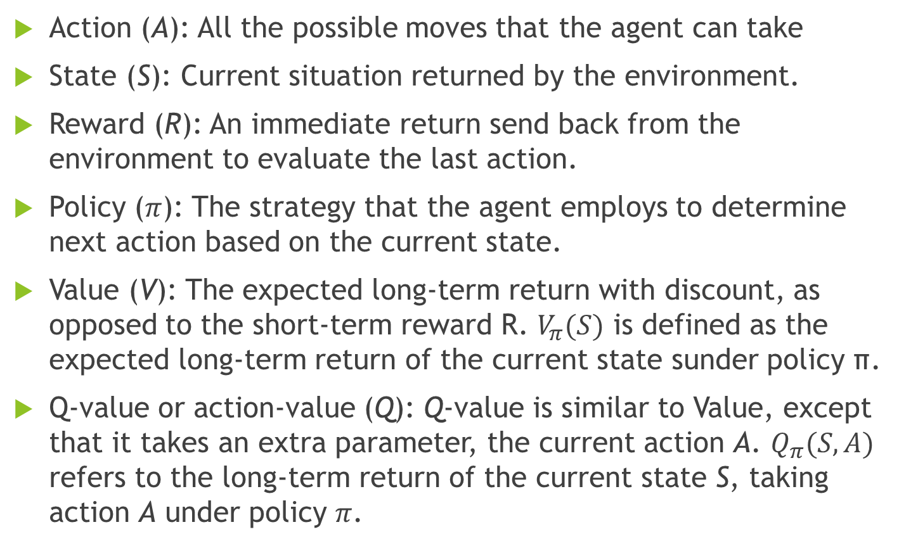
Introduction to Reinforcement Learning
Action (A): All the possible moves that the agent can take
State (S): Current situation returned by the environment.
Reward (R): An immediate return send back from the environment to evaluate the last action.
Policy ($π$): The strategy that the agent employs to determine next action based on the current state.
Value (V): The expected long-term return with discount, as opposed to the short-term reward R. $V_{π}(S)$ is defined as the expected long-term return of the current state sunder policy π.
Q-value or action-value (Q): Q-value is similar to Value, except that it takes an extra parameter, the current action A. $Q_{π}(S,A)$ refers to the long-term return of the current state S, taking action A under policy $π$.

Slide 12
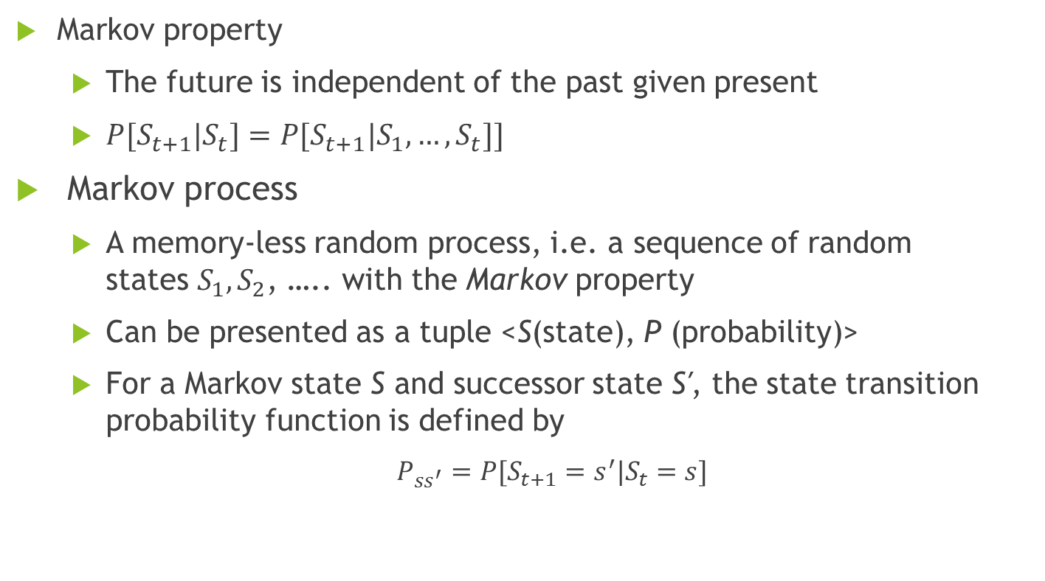
Introduction to Reinforcement Learning- Markov decision process (MDP)
Markov property
The future is independent of the past given present
$P[S_{t+1}|S_{t}]=P[S_{t+1}|S_{1},…,S_{t}]]$
Markov process
A memory-less random process, i.e. a sequence of random states $S_{1},S_{2}$, ….. with the Markov property
Can be presented as a tuple <S(state), P (probability)>
For a Markov state S and successor state S′, the state transition probability function is defined by
$P_{ss^{′}}=P[S_{t+1}=s^{′}|S_{t}=s]$

Slide 13
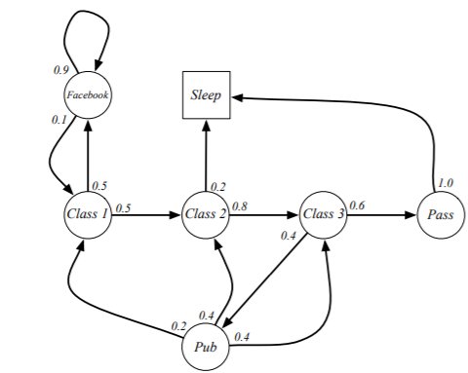
Introduction to Reinforcement Learning- Markov decision process (MDP)
Notes:
Here, we have different states with different successors, e.g. in Class 1 you might go to Class 2 with probability 0.5 or Facebook with probability 0.5. An episode would be for example [Class 1 →Class 2 → Class 3 → Pass →Sleep]. Sleep is the terminal state or absorbing state that terminates an episode.

Slide 14
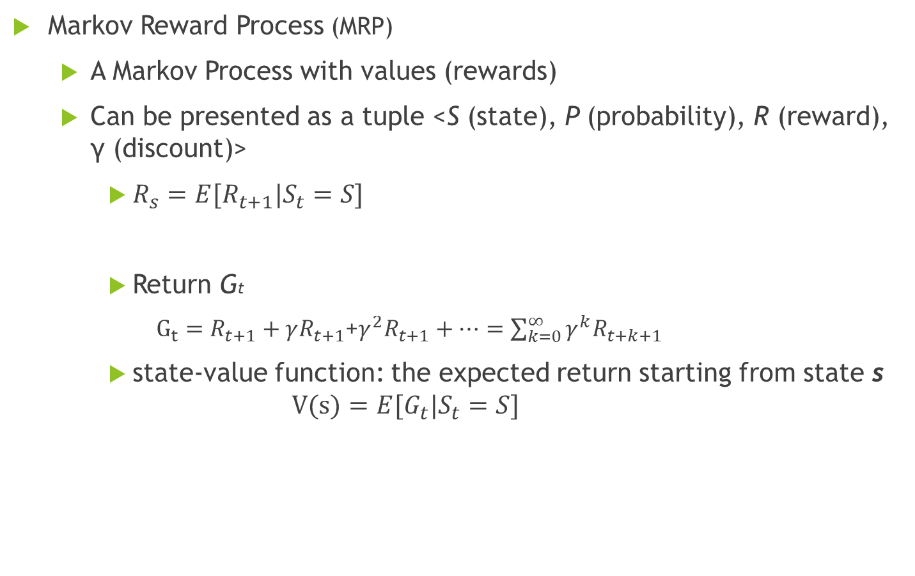
Introduction to Reinforcement Learning Markov decision process (MDP)
Markov Reward Process (MRP)
A Markov Process with values (rewards)
Can be presented as a tuple <S (state), P (probability), R (reward), γ (discount)>
$R_{s}=E[R_{t+1}|S_{t}=S]$
Return Gt
$G_{t}=R_{t+1}+γR_{t+1}$+${γ^{2}R}_{t+1}+…=\sum_{k=0}^{∞}{γ^{k}R_{t+k+1}}$
state-value function: the expected return starting from state s
$$V(s)=E[G_{t}|S_{t}=S]$$
Notes:
It turns out to be mathematically convenient to discount rewards, here we guarantee that the algorithm will converge, and avoid infinite returns in loopy Markov processes.
Another reason to discount rewards is that, the agent is not certain about what would happen in the future, it might be better to take the immediate reward rather than waiting in the hope to get a larger reward in the future,

Slide 15
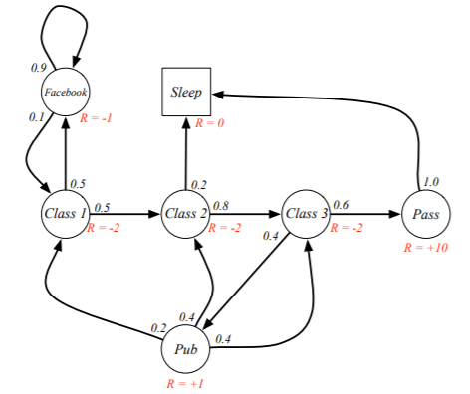
Introduction to Reinforcement Learning Markov decision process (MDP)

Slide 16
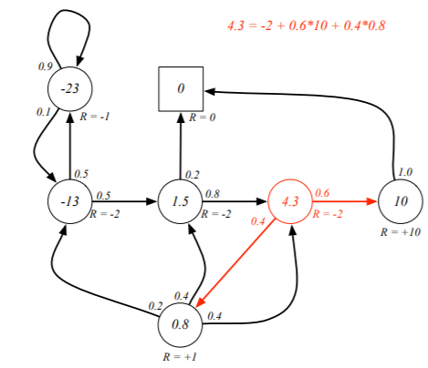
Introduction to Reinforcement Learning Markov decision process (MDP)

Slide 17
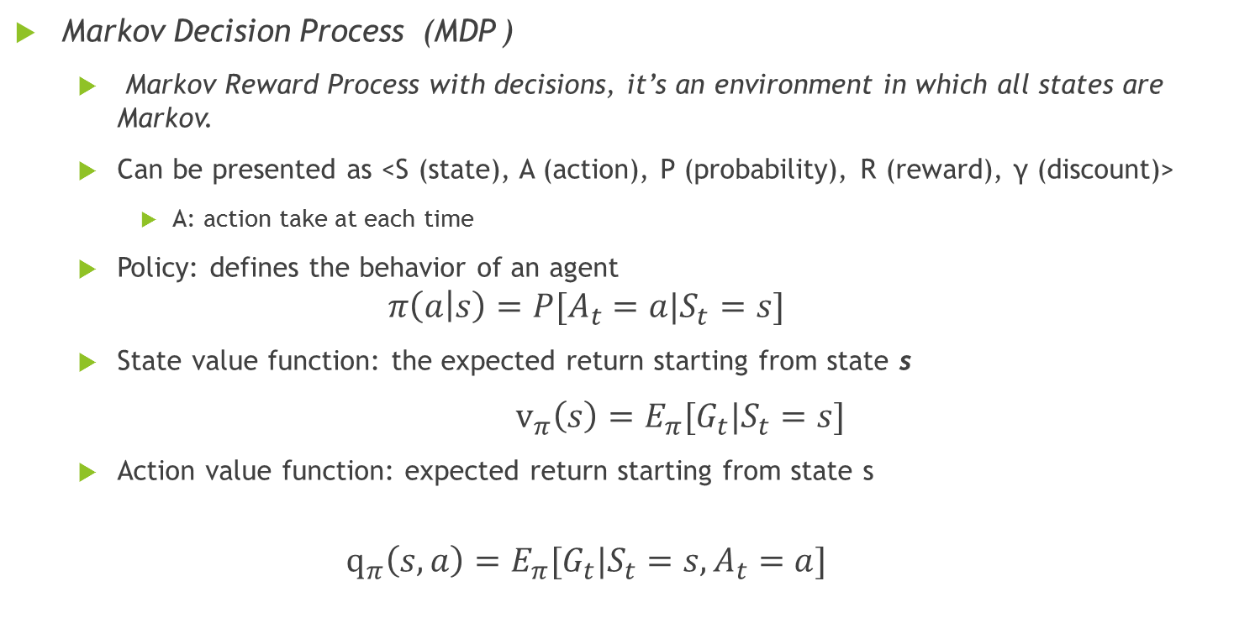
Introduction to Reinforcement Learning Markov decision process (MDP)
Markov Decision Process (MDP )
Markov Reward Process with decisions, it’s an environment in which all states are Markov.
Can be presented as <S (state), A (action), P (probability), R (reward), γ (discount)>
A: action take at each time
Policy: defines the behavior of an agent $π\left(a | s\right)=P[A_{t}=a|S_{t}=s]$
State value function: the expected return starting from state s
$v_{π}\left(s\right)=E_{π}[G_{t}|S_{t}=s]$
Action value function: expected return starting from state s
$$q_{π}\left(s,a\right)=E_{π}[G_{t}|S_{t}=s,A_{t}=a]$$
Notes:
It turns out to be mathematically convenient to discount rewards, here we guarantee that the algorithm will converge, and avoid infinite returns in loopy Markov processes.
Another reason to discount rewards is that, the agent is not certain about what would happen in the future, it might be better to take the immediate reward rather than waiting in the hope to get a larger reward in the future,

Slide 18
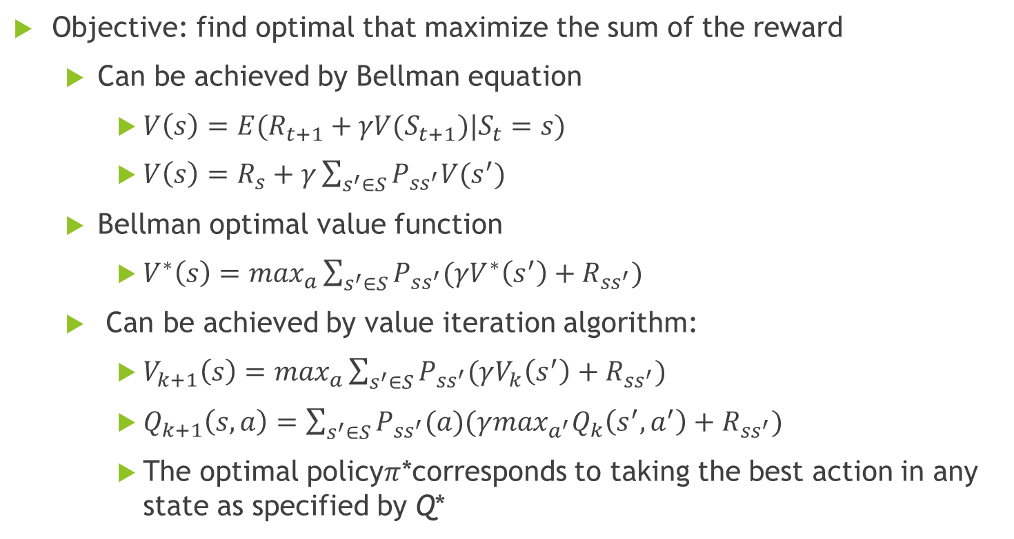
Introduction to Reinforcement Learning Markov decision process (MDP)
Objective: find optimal that maximize the sum of the reward
Can be achieved by Bellman equation
$V\left(s\right)=E(R_{t+1}+γV(S_{t+1})|S_{t}=s)$
$V\left(s\right)=R_{s}+γ\sum_{s^{′}∈S}{P_{ss^{′}}V(s^{′})}$
Bellman optimal value function
$V^{∗}\left(s\right)=\max_{a}\sum_{s^{′}∈S}{P_{ss^{′}}(γV^{∗}\left(s^{′}\right)+R_{ss^{′}})}$
Can be achieved by value iteration algorithm:
$V_{k+1}\left(s\right)=\max_{a}\sum_{s^{′}∈S}{P_{ss^{′}}(γV_{k}\left(s^{′}\right)+R_{ss^{′}})}$
$Q_{k+1}\left(s,a\right)=\sum_{s^{′}∈S}{P_{ss^{′}}(a)(γ\max_{a^{′}}Q_{k}\left(s^{′},a^{′}\right)+R_{ss^{′}})}$
The optimal policy$π$*corresponds to taking the best action in any state as specified by Q*
Notes:
Almost all reinforcement learning algorithms involve estimating value functions—functions
of states (or of state–action pairs) that estimate how good it is for the agent to be in a
given state (or how good it is to perform a given action in a given state). The notion
of “how good” here is defined in terms of future rewards that can be expected, or, to
be precise, in terms of expected return. Of course the rewards the agent can expect to
receive in the future depend on what actions it will take. Accordingly, value functions
are defined with respect to particular ways of acting, called policies

Slide 19
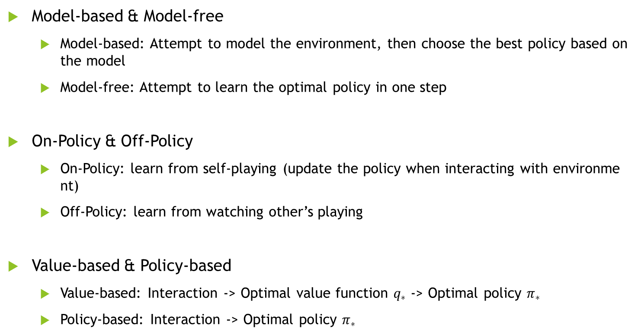
Overview reinforcement learning approaches
Model-based & Model-free
Model-based: Attempt to model the environment, then choose the best policy based on the model
Model-free: Attempt to learn the optimal policy in one step
On-Policy & Off-Policy
On-Policy: learn from self-playing (update the policy when interacting with environment)
Off-Policy: learn from watching other’s playing
Value-based & Policy-based
Value-based: Interaction -> Optimal value function $q_{∗}$ -> Optimal policy $π_{∗}$
Policy-based: Interaction -> Optimal policy $π_{∗}$
Notes:
Almost all reinforcement learning algorithms involve estimating value functions—functions
of states (or of state–action pairs) that estimate how good it is for the agent to be in a
given state (or how good it is to perform a given action in a given state). The notion
of “how good” here is defined in terms of future rewards that can be expected, or, to
be precise, in terms of expected return. Of course the rewards the agent can expect to
receive in the future depend on what actions it will take. Accordingly, value functions
are defined with respect to particular ways of acting, called policies.

Slide 20
Overview reinforcement learning approaches
Model-Based
MDP-Based
Monte-carlo update
Off-policy
Q-learning
Model-free
Value-based
Temporal Difference
On-policy
Sarsa
Policy-based
Policy gradient
Notes:
Model-free：不尝试去理解环境, 环境给什么就是什么，一步一步等待真实世界的反馈, 再根据反馈采取下一步行动。
Model-based：先理解真实世界是怎样的, 并建立一个模型来模拟现实世界的反馈，通过想象来预判断接下来将要发生的所有情况，然后选择这些想象情况中最好的那种，并依据这种情况来采取下一步的策略。它比 Model-free 多出了一个虚拟环境，还有想象力。
Policy based：通过感官分析所处的环境, 直接输出下一步要采取的各种动作的概率, 然后根据概率采取行动。
Value based：输出的是所有动作的价值, 根据最高价值来选动作，这类方法不能选取连续的动作。
Monte-carlo update：游戏开始后, 要等待游戏结束, 然后再总结这一回合中的所有转折点, 再更新行为准则。
Temporal-difference update：在游戏进行中每一步都在更新, 不用等待游戏的结束, 这样就能边玩边学习了。
On-policy：必须本人在场, 并且一定是本人边玩边学习。Use samples generated from the current policy
Off-policy：可以选择自己玩, 也可以选择看着别人玩, 通过看别人玩来学习别人的行为准则。Use samples from other policies
按照环境是否已知可以分为Model-based & Model-free；
按照学习方式可以分为On-Policy & Off-Policy；
按照学习目标可以分为Value-based & Policy-based。

Slide 21
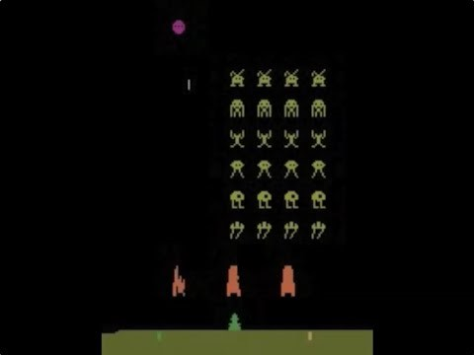
Case study – Atari games
https://www.youtube.com/watch?v=W2CAghUiofY
Notes:
作者：天津包子馅儿 链接：https://zhuanlan.zhihu.com/p/26052182 来源：知乎 著作权归作者所有。商业转载请联系作者获得授权，非商业转载请注明出处。 强化学习逐渐引起公众的注意要归功于谷歌DeepMind公司。DeepMind公司最初是由Demis Hassabis, Shane Legg和Mustafa Suleyman于2010年创立的。创始人Hassabis有三重身份：游戏开发者，神经科学家以及人工智能创业者。Hassabis的游戏开发者的身份使人不难理解DeepMind在nature上发表的第一篇论文是以雅达利（atari）游戏为背景的。同时，Hassabis又是国际象棋高手，对棋类很擅长，挑战完简单地atari游戏后再挑战公认的极其难的围棋游戏也很自然，于是就有了AlphaGo和李世石的2016之战和nature上的第二篇论文。一战成名之后，深度强化学习技术再次博得人的眼球。当然，DeepMind的成功离不开近几年取得突破进展的深度学习技术。本讲主要讲解DQN，也就是DeepMind发表在《Nature》上的第一篇论文。题目是：《Human-level control through deep reinforcement learning》
平心而论，这篇论文只有两个创新点，算法的大体框架是传统强化学习中的Q-learning。该算法，我们已经在强化学习入门第四讲时间差分方法中讲了。为了讲解方便，在这里，我们重复讲一遍。

Slide 22
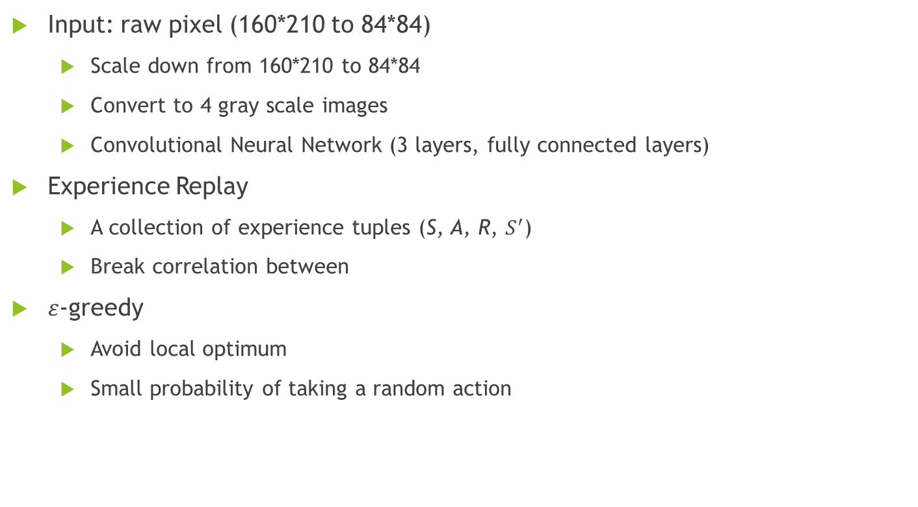
Case study – Atari games
Input: raw pixel (160*210 to 84*84)
Scale down from 160*210 to 84*84
Convert to 4 gray scale images
Convolutional Neural Network (3 layers, fully connected layers)
Experience Replay
A collection of experience tuples (S, A, R, $S^{′}$)
Break correlation between
$ε$-greedy
Avoid local optimum
Small probability of taking a random action
Notes:
Waste resources (recall experiences)
Could learn multiple times
Sample
When the agent interacts with the environment, the sequence of experience tuples can be highly correlated. The naive Q-learning algorithm that learns from each of these experience tuples in sequential order runs the risk of getting swayed by the effects of this correlation. By instead keeping track of a replay buffer and using experience replay to sample from the buffer at random, we can prevent action values from oscillating or diverging catastrophically.
DQN对Q-learning的修改主要体现在以下三个方面：
DQN利用深度卷积神经网络逼近值函数
DQN利用了经验回放对强化学习的学习过程进行训练
DQN独立设置了目标网络来单独处理时间差分算法中的TD偏差。

Slide 23
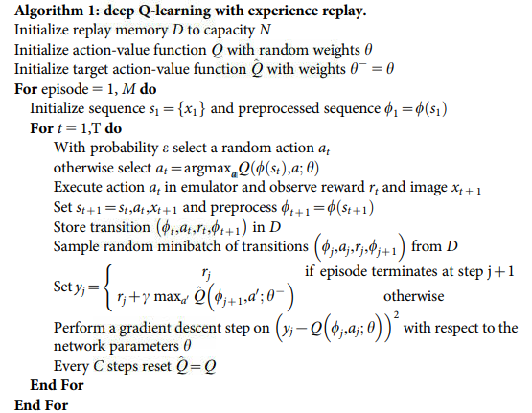
Case study – Atari games

Slide 24
Other applications - SeqGAN: Sequence Generative Adversarial Nets with Policy Gradient
Problem:
How to use Generative Adversarial Nets to generate synthetic population imitating the original population . The synthetic population hides the record-level information, while keeping the statistical properties of the original population
Difficulty:
Cannot use back propagation on categorical variables

Slide 25
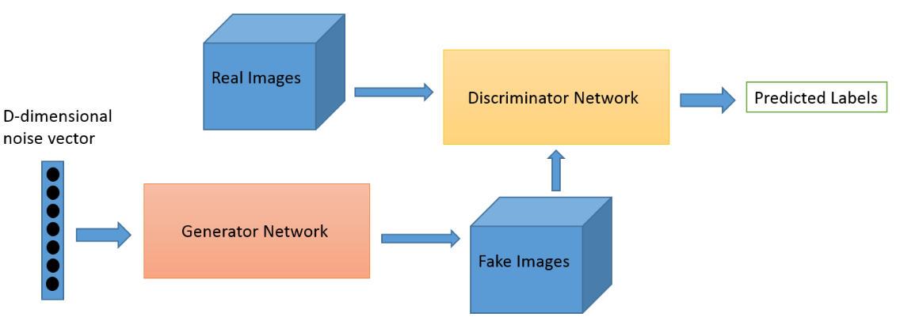
Other applications - SeqGAN: Sequence Generative Adversarial Nets with Policy Gradient
Generative Adversarial Nets:
Notes:
GAN 主要分为两部分：生成模型和判别模型。生成模型的作用是模拟真实数据的分布，判别模型的作用是判断一个样本是真实的样本还是生成的样本，GAN 的目标是训练一个生成模型完美的拟合真实数据分布使得判别模型无法区分。
具体解释为：
对于生成模型G ，它希望D 判别真实数x的概率低，判别生成数据G(z)的概率高，所以V(D,G)的值小；
对于判别模型D它希望判别真实数据x 的概率高，判别生成数据G(z) 的概率低，所以V(D,G) 的值大。
GAN在图像领域的应用较多，在文本方面效果不佳的原因主要是GAN 在生成连续离散序列时会遇到两个问题：一是因为生成器的输出是离散的，梯度更新从判别器传到生成器比较困难；二是判别器只有当序列被完全生成后才能进行判断，但此刻指导用处已不太大，而如果生成器生成序列的同时判别器来判断，如何平衡当前序列的分数和未来序列的分数又是一个难题。

Slide 26
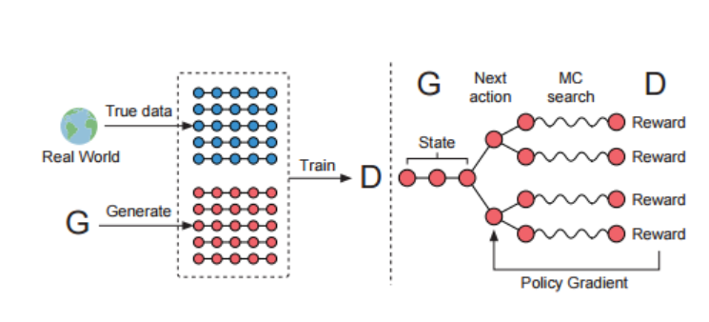
Other applications - SeqGAN: Sequence Generative Adversarial Nets with Policy Gradient
Notes:
在这篇论文中，作者提出了一个序列生成模型——SeqGAN ，来解决上述这两个问题。作者将生成器看作是强化学习中的stochastic policy，这样SeqGAN 就可以直接通过gradient policy update 避免生成器中的可导问题。同时，判别器对整个序列的评分作为强化学习的奖励信号可以通过Monte Carlo 搜索传递到序列生成的中间时刻。
具体来说，作者将生成器生成序列的过程看做是一个强化学习中的序列决策过程。生成模型被看作一个agent，目前为止已生成的序列表示当前state，下一个要生成的单词则是采取的action，判别模型对序列的评价分数则是返回的reward。
1、左图为GAN网络训练的步骤1，即根据真实样本和伪造样本训练判别器D网 络，这里的D网络用的CNN实现。
2、右图为GAN网络训练的步骤2，根据D网络回传的判别概率通过增强学习更新G网络，这里的G网络用的LSTM实现。
3、已知G网络的更新策略是增强学习，而增强学习的三个要素点状态state，action，reward。
本文state指的当前timestep之前的decode结果，action指的当前待解码词，D网络判别伪造数据的置信度即为奖励，伪造数据越逼真则相应奖励越大，但该奖励是总的奖励，分配到每个词选择上的reward则采用了以下的近似方法。
简单解释，即当解码到t时，即对后面T-t个timestep采用蒙特卡洛搜索搜索出N条路径，将这N条路径分别和已经decode的结果组成N条完整输出，然后将D网络对应奖励的平均值作为reward.因为当t=T时无法再向后探索路径，所以直接以完整decode结果的奖励作为reward。蒙特卡洛搜索是指在选择下一个节点的时候用蒙特卡洛采样的方式，而蒙特卡洛采样是指根据当前输出词表的置信度随机采样。
1、随机初始化G网络和D网络参数
2、通过MLE预训练G网络，目的是提高G网络的搜索效率
3、通过G网络生成部分负样预训练D网络。
4、通过G网络生成sequence用D网络去评判，得到reward。

Slide 27
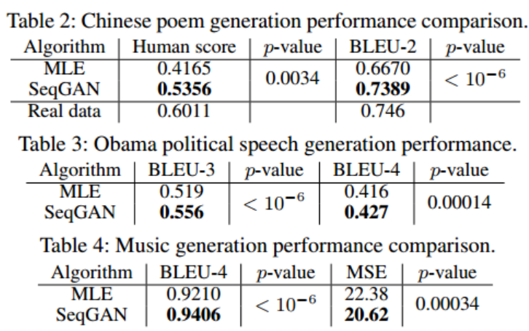
Other applications - SeqGAN: Sequence Generative Adversarial Nets with Policy Gradient

Slide 28
Question?

